Slide 1
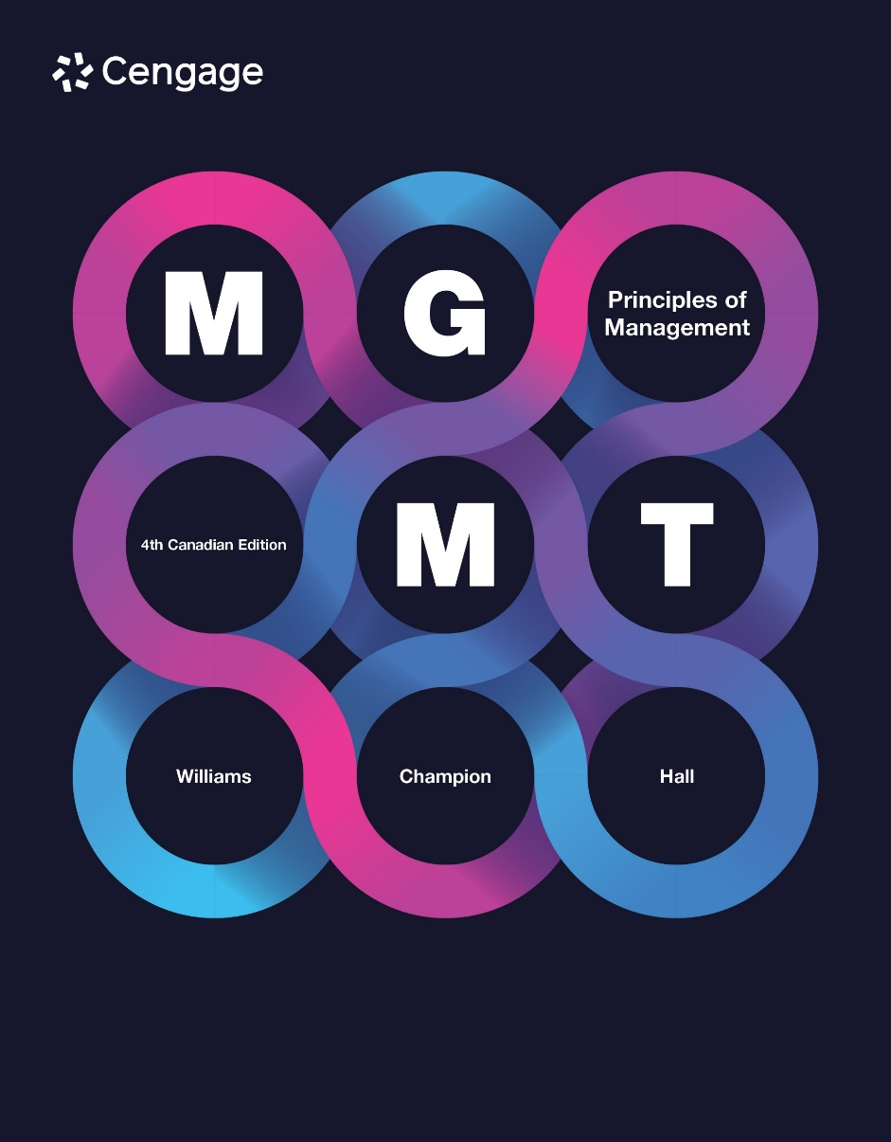
BUSA 7250
Dr Ike Hall, MSc, MBA, BEng
1-5 Sep 2025

Slide 2
WEEK 1 LECTURE- Chapter 5
Organizational Strategy

Slide 3
Four Basic Strategies
Competitive Advantage
Broad
Target
1. Cost (What process?)
2. Differentiation (How?)
Competitive Scope
3. Focus (Where?, Whom?) Cost (What Process?)
4. Focus (Where?, Whom?) Differentiation (How?)
Narrow
Target

Slide 4
DIFFERENTIATE (HOW)?….. COST (HOW…& WHY)?.....

Slide 5
FOCUS – “ic” (Market Segmentation) DEMOGRAPHIC GEOGRAPHIC PYSCHOGRAPHIC

Slide 6
ATTIBUTES: (Doing ONE thing extremely well) Why do we buy McDonald’s Hamburgers – because they are the best hamburger around? Do we buy transportation when we buy a Harley-Davidson Motorcycle? Differentiation strategies are basically tied to “attributes” (what the client receives… the benefits they get).

Slide 7
Strategy-Making Process
1. Assess need for strategic change
2. Conduct
Situational Analysis
3. Choose Strategic Alternatives
Avoid Competitive Inertia
Look for Strategic Dissonance
2
6-7
Notes:
Great deal uncertainty in strategic business environments.
Top-level managers often slow to recognize need for strategic change, especially @ successful companies that created & sustained competitive advantages.
B/c they are aware of strategies that made companies successful, they continue to rely on them, even as competition changes.
Success often leads to competitive inertia— reluctance to change strategies/ competitive practices that have been successful in past.
Strategic dissonance: discrepancy b/w upper management’s intended strategy & strategy actually implemented by lower levels of management. Upper management sets overall company strategy, middle & lower-level managers must carry out strategy.
Middle & lower-level managers held directly responsible for meeting customers’ needs & responding to competitors’ actions. While strategic dissonance indicate these managers not doing what they should to carry out company strategy, can mean that intended strategy is out of date & needs to be changed.

Slide 8

Situational Analysis (Internal and External Analysis)
Distinctive competences & Core capabilities
Shadow-strategy task force
Environmental scanning (Porter)
Strategic groups (Mapping)
PESTEEL analysis
© Neustockimages/iStockphoto.com
5-8
Notes:
The internal environment assessment often begins by looking at the organization’s distinctive competencies and core capabilities.
Distinctive competence: something a company can make, do, or perform better than its competitors. Distinctive competencies are tangible—a product or service is faster, cheaper, or better. The core capabilities that produce distinctive competencies are not.
Core capabilities: less visible, internal decision-making routines, problem-solving processes, and organization cultures that determine how efficiently inputs can be turned into outputs.
In assessing opportunities and threats in the external environment, managers use environmental scanning to identify specific opportunities and threats.
The goal of a shadow-strategy task force is to actively seek out its own company’s weaknesses and determine how other companies could exploit them for competitive advantage. To make sure the task force challenges conventional thinking, members should be independent-minded, come from a variety of company functions and levels, and have the access and the authority to question the company’s current strategic actions and intent.
Environmental scanning involves searching the environment for important events/issues that might affect the organization.
Strategic group: group of other companies within the company’s industry that top managers choose for comparing, evaluating, and benchmarking the company’s strategic threats and opportunities.
The easiest way to examine factors in external environment is to go through PESTEEL analysis.
Political forces include government trade agreements, taxation, government ownership, and laws/regulations that may affect businesses.
Economic forces include interest rates, exchange rates, GDP and other general economic indicators, unemployment, and other factors over which a company has no control.
Social and demographic factors include age, ethnicity, housing, purchasing psychometrics, and other changes/trends that affect consumer behaviours.
Technological factors include new processes, new methods, new discoveries, and new ways of communicating, none of which the company can control.
External-Employee factors include concern for employees all the way down the chain (global suppliers), fair wages, providing healthy and safe work environments, providing workplaces free from harassment and discrimination, and employee assistance programs.
Legal factors would include laws and regulations that affect companies, compliance with provincial and federal laws (labour laws), international law, and legal obligations for things like pipelines and mining in Canada or other countries.

Slide 9
Assessing the External Environment Macro-Drivers
PEST FORCES FOR STRATEGY
Political
Economic
Social/
Demographic
Technological
-
OPPORTUNITIES
&
THREATS

Slide 10
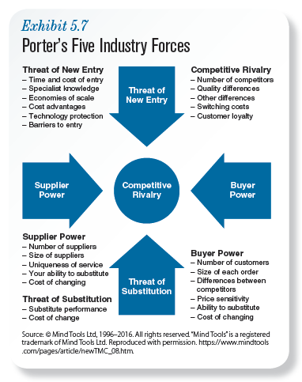
10
5-10
Notes:
Character of rivalry measures the intensity of competitive behaviour between companies in an industry. Is competition among firms aggressive and cutthroat, or do competitors focus more on serving customers than attacking each other? Both industry attractiveness and profitability decrease when rivalry is cutthroat.
Threat of new entrants measures the degree to which barriers to entry make it easy/difficult for new companies to get started in an industry. If it’s easy for new companies to get started in an industry, then competition will increase and prices and profits will fall.
Threat of substitute products/services measures the ease with which customers can find substitutes for an industry’s products/services. If customers can easily find substitute products/services, competition will be greater and profits will be lower. If few or no substitutes, competition will be weaker and profits will be higher.
Bargaining power of suppliers measures the influence that suppliers of parts, materials, and services to firms in an industry have on prices of inputs. If an industry has numerous suppliers from whom to buy parts, materials, and services, companies will be able to bargain with suppliers to keep prices low.
Bargaining power of buyers measures the influence that customers have on a firm’s prices. If a company is dependent on few high-volume buyers, those buyers will typically have enough bargaining power to dictate prices. If a company sells popular product/service to multiple buyers, then the company has more power to set prices.

Slide 11
Sample Situational Analysis
STRENGTHS Techy image Efficient Consultant Product innovator | WEAKNESSES Poor experience Lagging in ecommerce No clear “record”
OPPORTUNITIES QR codes & IT growth Minimal barriers of entry Growth in BC market | THREATS Inflation is increasing Slowdown in some sectors Growing bargaining power of suppliers and customers
5-11

Slide 12
Industry-Level Strategies: How Should We Compete in This Industry?
Five Industry Forces
PEST
SWOT- TOWS
12
5-12
Notes:
Industry-level strategy is a corporate strategy that addresses the question “How should we compete in this industry?”

Slide 13
Requirements for Sustainable Competitive Advantage
Valuable Resources
Rare Resources
Sustainable Competitive
Advantage
Imperfectly/Costly Imitable Resources
Organizational
Capabilities
1
6-13
Notes:
4 conditions must be met if firm’s resources used to achieve sustainable competitive advantage. Resources must be valuable, rare, imperfectly imitable, nonsubstitutable.
Valuable resources allow companies to improve efficiency/ effectiveness. Changes in customer demand & preferences, competitors’ actions, & technology can make once-valuable resources less valuable. For sustained competitive advantage, valuable resources must be rare resources. How can company sustain competitive advantage if all competitors have similar resources/capabilities?
Rare resources: resources that not controlled/possessed by competing firms, necessary to sustain competitive advantage. For sustained competitive advantage, other firms must be unable to imitate/find substitutes for those valuable, rare resources.
Imperfectly imitable resources impossible or extremely costly or difficult to duplicate. Valuable, rare, imperfectly imitable resources can produce sustainable competitive advantage only if they are also no substitutable resources, meaning no other resources can replace them & produce similar value/ competitive advantage.

Slide 14
Corporate-Level Strategies
PORTFOLIO STRATEGY
GRAND STRATEGIES
Acquisitions
Unrelated diversification
Related diversification
Single businesses
BCG Matrix
Stars
Question marks
Cash cows
Dogs
Growth
Stability
Retrenchment/recovery
3
Notes:
One of the standard strategies for stock market investors is diversification: buy stocks in a variety of companies in different industries. The purpose of this strategy is to reduce risk in the overall stock portfolio (i.e. the entire collection of stocks). The basic idea is simple: If you invest in 10 companies in 10 different industries, you won’t lose your entire investment if one company performs poorly. Furthermore, because they’re in different industries, one company’s losses are likely to be offset by another company’s gains. Portfolio strategy is based on these same ideas.
Portfolio strategy is a strategy that minimizes risk by diversifying investment among various businesses or product lines. Managers who use portfolio strategy are often on the lookout for acquisitions—other companies to buy.
Portfolio strategy can reduce risk even more through unrelated diversification—creating or acquiring companies in unrelated businesses. The BCG Matrix is the best-known portfolio strategy that managers use to categorize their corporation’s businesses.
Grand strategies include growth, stability, and retrenchment/recovery.

Slide 15
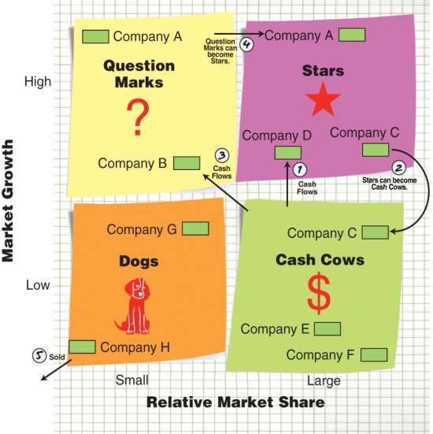
Problems with Portfolio Strategy
Notes:
BCG matrix: portfolio strategy that managers use to categorize corporation’s businesses by growth rate & relative market share, helping them decide how to invest corporate funds.
BCG Matrix separates businesses into 4 categories, based on how fast market growing (high-growth/ low-growth) & size of business’s share that market (high/ low).
Stars: companies that have large share of fast-growing market. To take advantage of star’s fast-growing market & strength in market (large share), corp must invest substantially in it. Investment usually worthwhile, b/c many stars produce sizable future profits.
Question marks: companies that have small share of fast-growing market. If corp invests in companies, may eventually become stars, but relative weakness in market (small share) makes investing in question marks more risky than investing in stars
Cash cows: companies that have large share of slow-growing market. Companies in situation often highly profitable, hence name “cash cow.”
Dogs: companies that have small share of slow-growing market. As the name “dogs” suggests, having small share of slow-growth market is often not profitable.
Arrow 1: While substantial cash flows from cash cows last, should be reinvested in stars.
Arrow 2: Over time, as market growth slows, some stars may turn into cash cows.
Arrow 3: Cash flows should be directed to some question marks b/c of greater potential in fast-growing market.
Arrow 4: Some question marks will become stars over time, as small markets become larger ones.
Arrow 5: B/c dogs lose $, they should “find new owner” or be “taken to the pound” (sold/closed down & liquidated for assets).

Slide 16
Problems with Portfolio Strategy
Unrelated diversification does not reduce risk.
Present performance is used to predict future performance.
Cash cows fail to aggressively pursue opportunities and defense themselves from threats.
Being labeled a “cash cow” can hurt employee morale.
Companies often overpay to acquire stars.
Acquiring firms often treat stars as “conquered foes.”

Slide 17
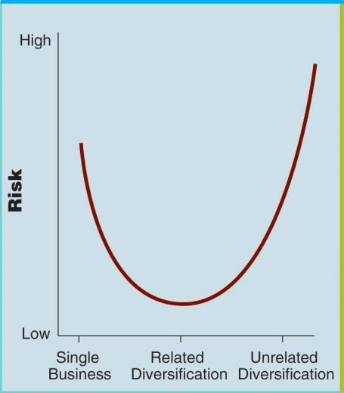
U-Shaped Relationship Between Diversification and Risk
3.1
6-17
Notes:
While BCG matrix & other forms of portfolio strategy relatively popular among managers, portfolio strategy has drawbacks. Most significant is evidence does not support usefulness of acquiring unrelated businesses.
There is U-shaped relationship b/w diversification & risk. Left side of curve shows that single businesses w/ no diversification are extremely risky (if single business fails, entire business fails). Portfolio strategy of diversifying is correct—competing in variety of different businesses can lower risk. Portfolio strategy is partly wrong—right side of the curve shows that conglomerates composed of completely unrelated businesses even riskier than single, undiversified businesses.

Slide 18
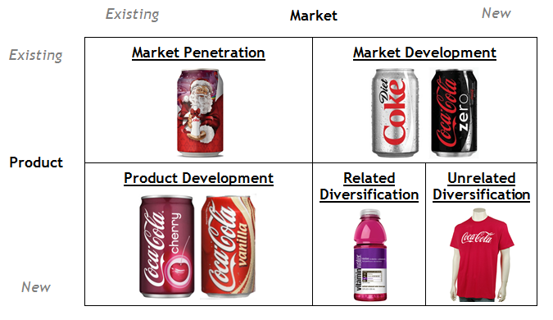
ANSOFF MATRIX

Slide 19
Firm-Level Strategies
How Should We Compete Against an Established Firm?
Direct Competition
Resource Similarity
Responses
Attacks
Market Commonality
Strategic Tactics
19
5-19
Notes:
Firm-level strategy addresses the question “How should we compete against a particular firm?”
Direct competition is the rivalry between two companies offering similar products and services that acknowledge each other as rivals and take offensive and defensive positions as they act and react to each other’s strategic actions. Factors determine the extent to which firms will be in direct competition with each other: market commonality and resource similarity.
Market commonality is the degree to which two companies have overlapping products, services, or customers in multiple markets. The more markets in which there is product, service, or customer overlap, the more intense the direct competition is between the two companies.
Resource similarity is the extent to which a competitor has a similar amount/kinds of resources, similar assets, capabilities, processes, information, and knowledge used to create/sustain an advantage over its competitors. From a competitive standpoint, resource similarity means that strategic actions that your company takes can be matched by direct competitors.
Firms in direct competition can make two basic strategic moves: attacks and responses.
An attack is a competitive move designed to reduce a rival’s market share or profits.
A response is a countermove, prompted by a rival’s attack, that is designed to defend or improve a company’s market share or profit.
Market commonality and resource similarity determine the likelihood of an attack or response—that is, whether a company is likely to attack a direct competitor or to strike back with a strong response when attacked. When market commonality is strong and companies have overlapping products, services, or customers in multiple markets, there is less motivation to attack and more motivation to respond to an attack. The reason for this is straightforward: when firms are direct competitors in a large number of markets, they have a great deal at stake. (Example: GE vs. Caterpillar)
When resource similarity is strong, the responding firm will generally be able to match the strategic moves of the attacking firm. Consequently, a firm is less likely to attack firms with similar levels of resources because it is unlikely to gain any sustained advantage when the responding firms strike back. On the other hand, if one firm is substantially stronger than another (i.e., low resource similarity), then a competitive attack is more likely to produce sustained competitive advantage.

Slide 20
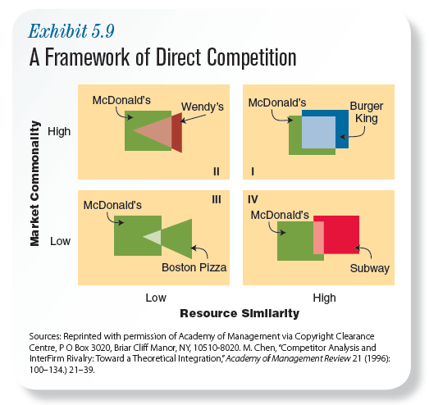
Firm-Level Strategies
20
5-20
Notes:
The shaded area in each quadrant depicts market commonality. The larger the shaded area, the greater the market commonality. The shapes depict resource similarity, with the rectangles representing one set of competitive resources and the triangles representing another.
Quadrant I shows two companies in direct competition because they have similar resources at their disposal and a high degree of market commonality as they try to sell similar products/services to similar customers.
Quadrant II, the shaded parts of the triangle and rectangle, show two companies going after similar customers with some similar products/services but doing so with different competitive resources.
Quadrant III, a very small shaded overlap, shows two companies with different competitive resources and little market commonality.
Quadrant IV, a shaded overlap between two rectangles, shows two companies competing with similar resources but with little market commonality.

Slide 21
Firm-Level Strategies
Red Ocean Strategy
Blue Ocean Strategy
Compete in existing market space.
Beat the competition.
Exploit existing demand.
Make the value-cost trade-off.
Align the whole system of a firm’s activities with its strategic choice of how to differentiate.
Create uncontested market space.
Make the competition irrelevant.
Create and capture new demand.
Break the value-price trade-off.
Align the whole system of a firm’s activities in pursuit of your differentiation.
© Kim & Mauborgne. All rights reserved
Notes:
Source: https://www.blueoceanstrategy.com/tools/red-ocean-vs-blue-ocean-strategy/
Using the ocean as a metaphor, Professors Renée Mauborgne and W. Chan Kim describe highly competitive markets as shark-infested waters. The water is red with blood from continual attacks and responses, and any gains made by one company are incremental at best and bound to be ceded in the next shark ﬁght. The only hope for survival is to pursue innovations that take you out of the red ocean and into the deep blue ocean, where there are no competitors.
The war between GE and Caterpillar Locomotives is an example of a red ocean. Canadian Tire’s new strategy of kiosks and new, smaller, more nimble stores could be seen as entering a blue ocean. Canada’s own Cirque du Soleil is another clear example of a blue ocean. Cirque du Soleil created a whole new category of entertainment.

